Slide 1
Conditional Stroke Recovery for Fine-Grained Sketch-Based Image Retrieval
Zhixin Ling
20212010005@fudan.edu.cn
Fudan University
Zhen Xing
zxing20@fudan.edu.cn
Fudan University
Jian Zhou
19212010009@fudan.edu.cn
Fudan University
Xiangdong Zhou*
xdzhou@fudan.edu.cn
Fudan University

Slide 2
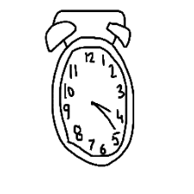
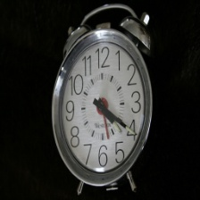
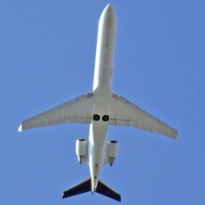
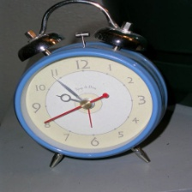
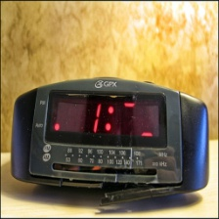
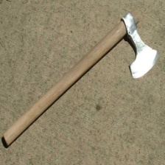
1. Task of FG-SBIR
Coarse-Grained Sketch-Based Image Retrieval (CG-SBIR)
Fine-Grained Sketch-Based Image Retrieval (FG-SBIR)
The Query Sketch
The Query Sketch
Positive Cases
Negative Cases
Negative Cases
Positive Case

Slide 3
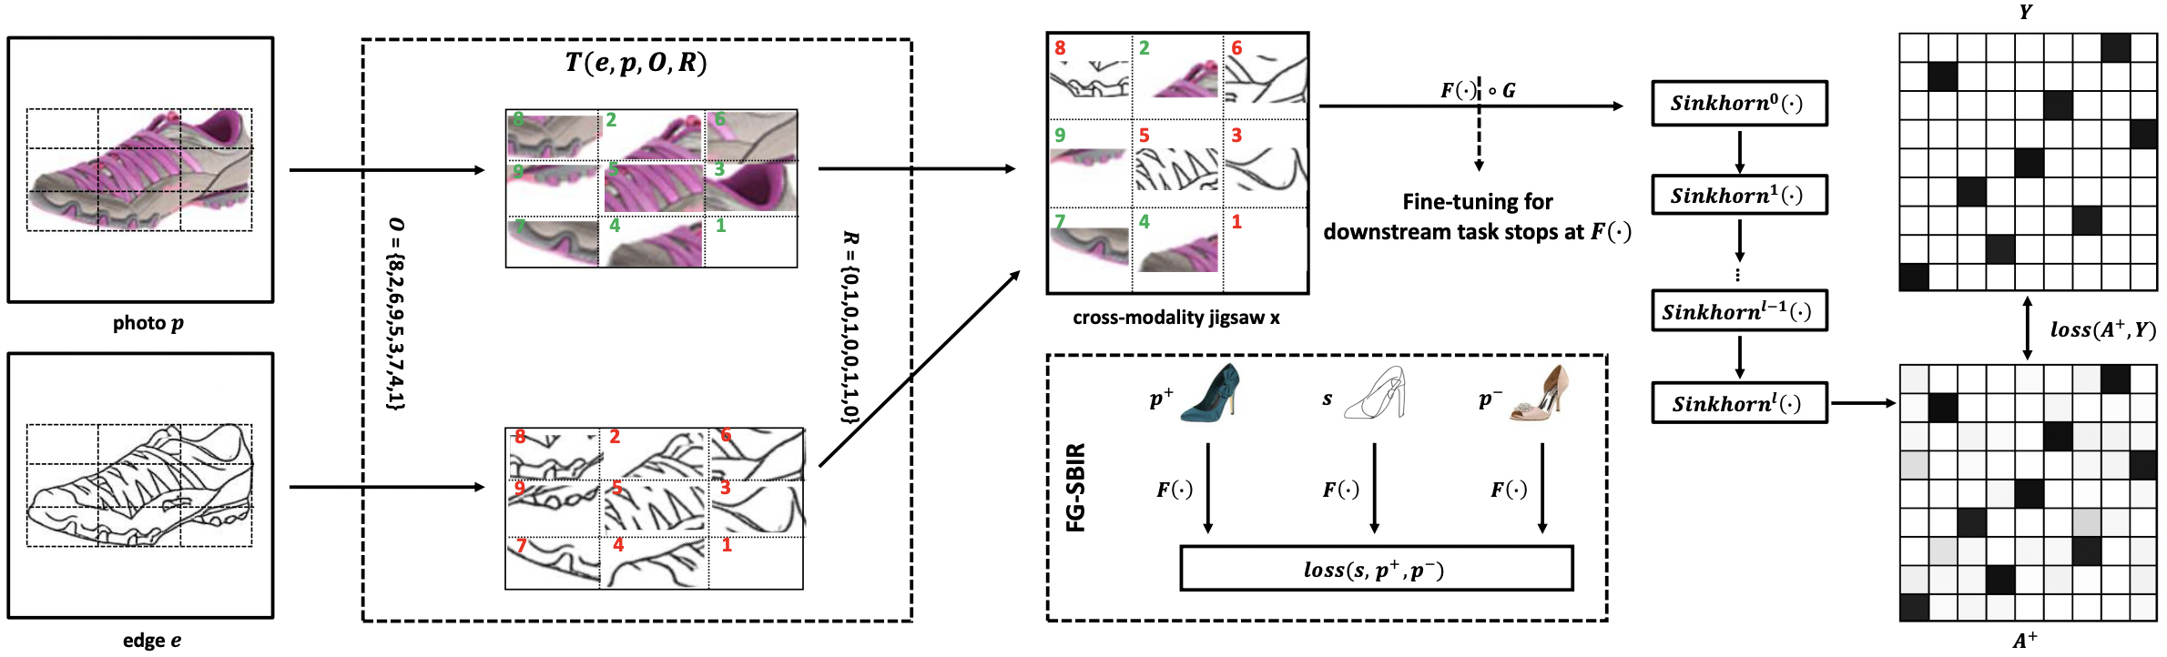

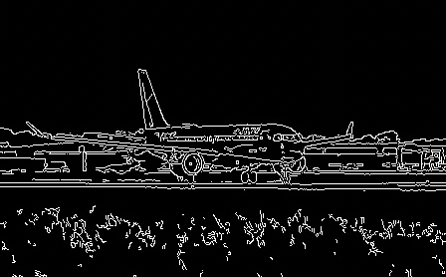
2. Related Work: Jigsaw Puzzle for FG-SBIR
JP-1. Learn local fine-grained correspondence.
JP-2. Grid region discards semantic information.
JP-3. Black background confuses the model.
JP-4. Cannot tolerate image background.
canny

Slide 4
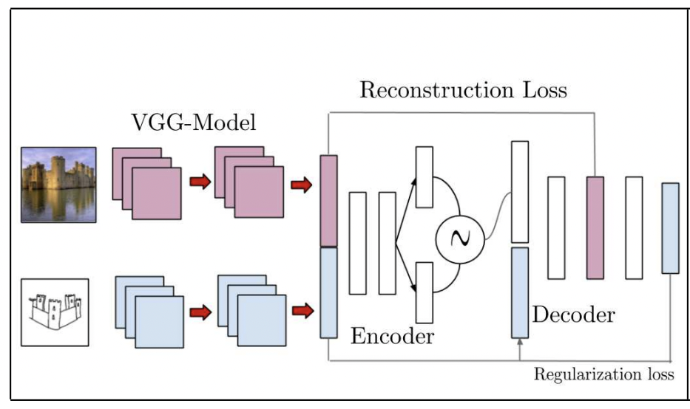
2. Related Work: CVAE for zero-shot CG-SBIR
CVAE-1. Explicitly establish correspondence via feature-level reconstruction.
CVAE-2. Sketch-to-image relation is uncertain, that is, not one-to-one mapping.
CVAE-3. Only work on category-level SBIR.

Slide 5
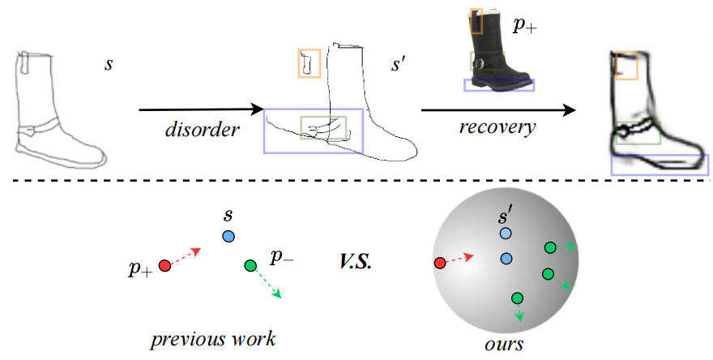
3. Our method: Main Idea
1) The top part shows an auxiliary recovery task conditioned by the paired image p₊.
2) The bottom part compares common triplet losses with our double-anchor InfoNCE loss.

Slide 6
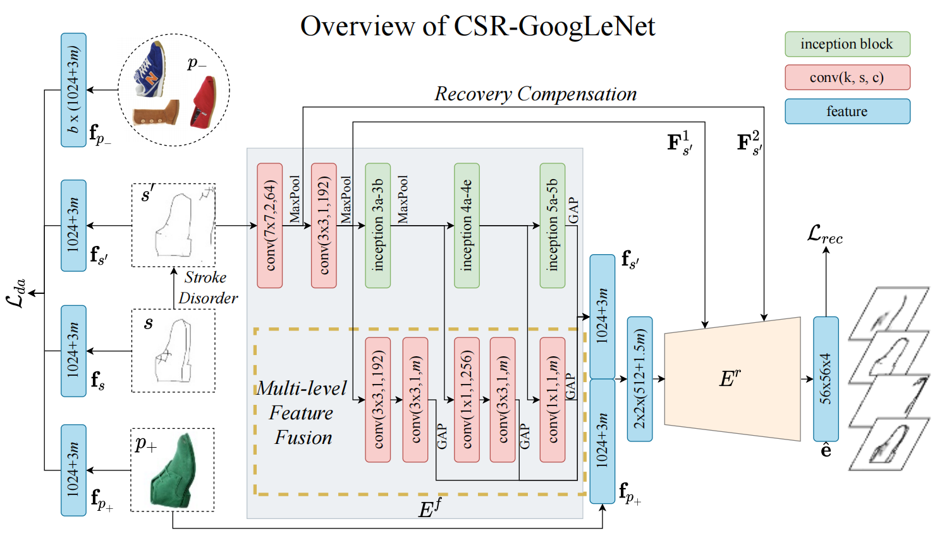
3. Our method: Overview of Conditional Stroke Recovery
CSR-1. Explicitly establish fine-grained correspondence via pixel-level reconstruction.
CSR-2. Take the paired image into consideration to eliminate mapping uncertainty.
CSR-3. We extract complete strokes to prevent loss of semantic information.
CSR-4. We improve feature quality by simplifying reconstruction network.

Slide 7
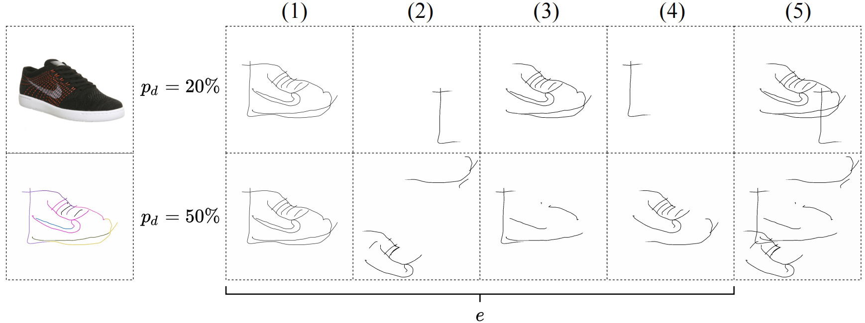
3. Our method: Reconstruction Targets
There are actually four channels to reconstruct.
We ease the reconstruction task by first distinguishing disordered strokes from undisordered ones.

Slide 8


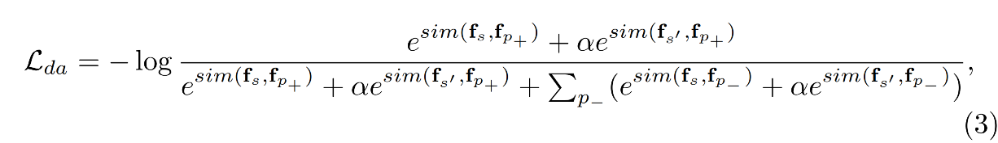
3. Our method: Double-Anchor InfoNCE
Triplet loss to single-anchor InfoNCE:
1. support cosine-distance retrieval
single-anchor InfoNCE to double-anchor InfoNCE:
2. maintain anchor modality (sparse sketch should be the anchor)
3. reduce gap among three styles

Slide 9
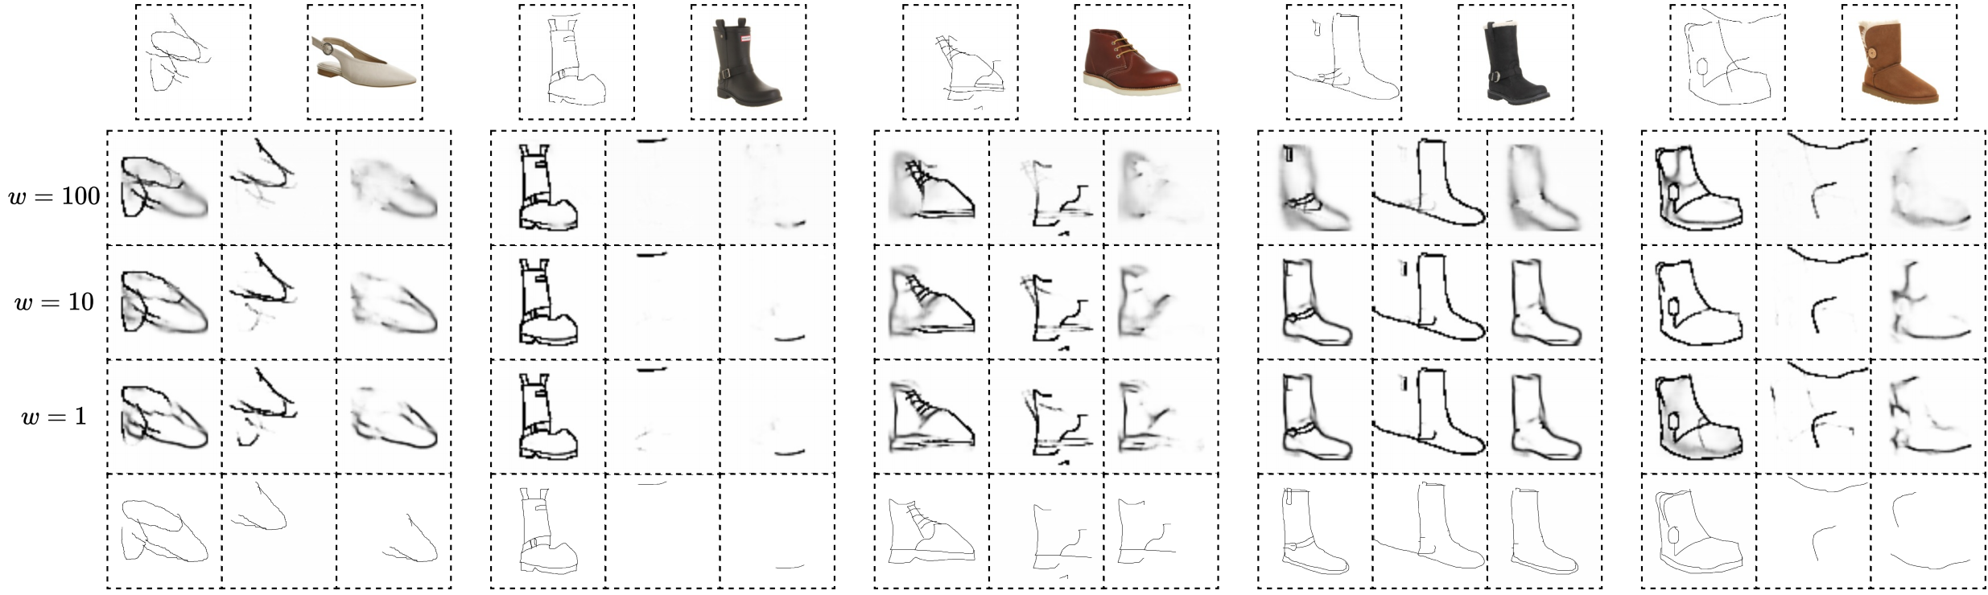
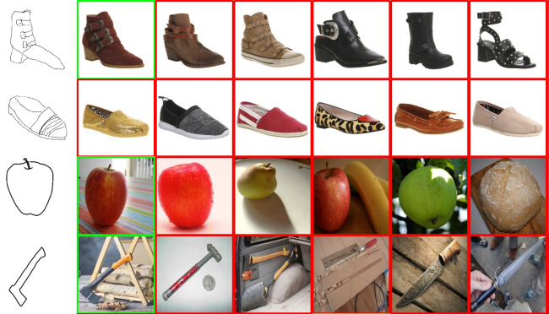
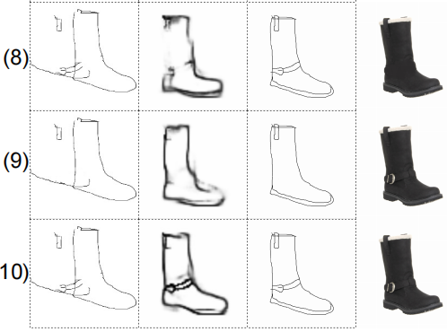
4. Results: Qualitive Visualization

Slide 10
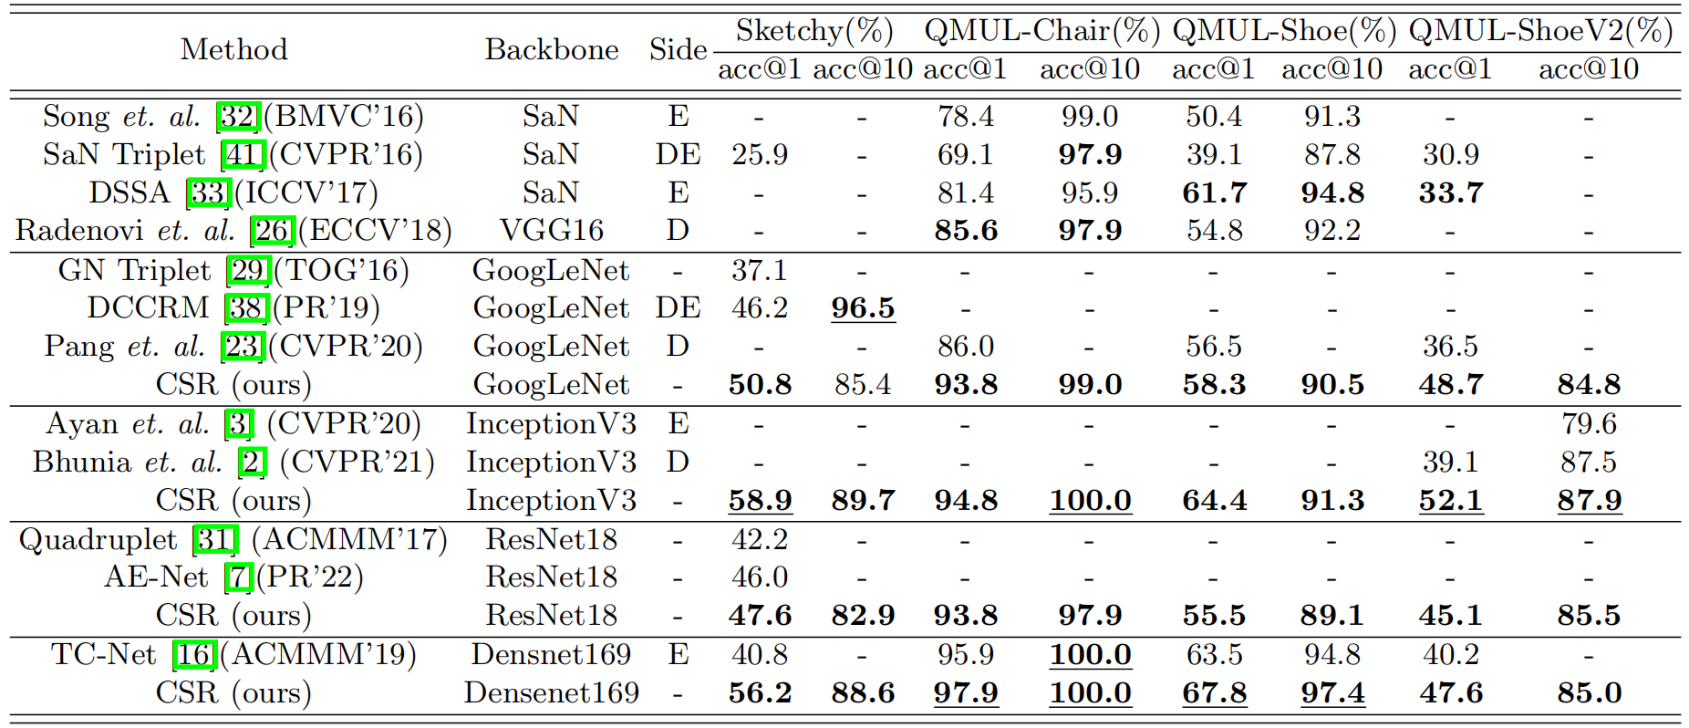
4. Results: Quatative Comparison

